Slide 1



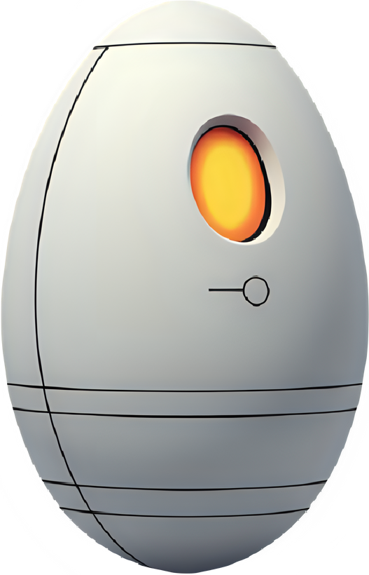
COMP6600 - Artificial Inteligence
EGG CLASSIFICATION MODEL
Deep learning classifier for egg images
Matheus Pupp de Araujo Rosa
Poultry Science Department
Auburn University

Slide 2

COMP6600 - Artificial Inteligence
INTRODUCTION
Eggshell quality;
Incubatory biosecurity;
CNN;
VGG19 architecture.
Auburn University

Slide 3
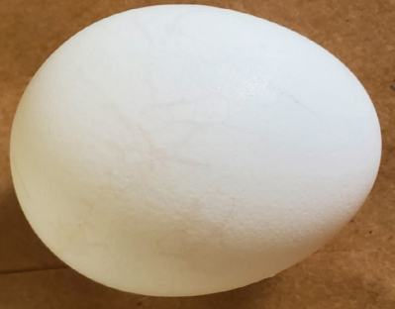
COMP6600 - Artificial Inteligence
INTRODUCTION
Eggshell quality
Shell integrity;
Contamination;
Auburn University
Cracked egg [2]

Slide 4
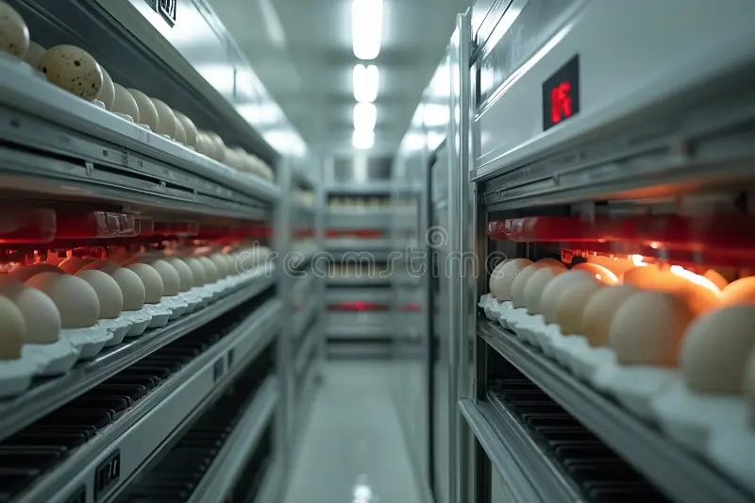
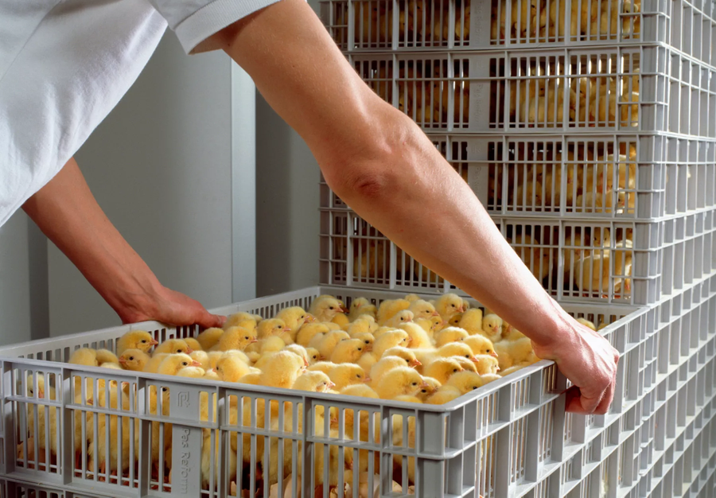
COMP6600 - Artificial Inteligence
Egg incubators (https://tinyurl.com/vauzw5xf)
INTRODUCTION
Incubatory biosecurity;
Contamination;
Chicks quality;
Economic loss.
Auburn University
Chicks after hatching (https://tinyurl.com/3fdj3evd)

Slide 5


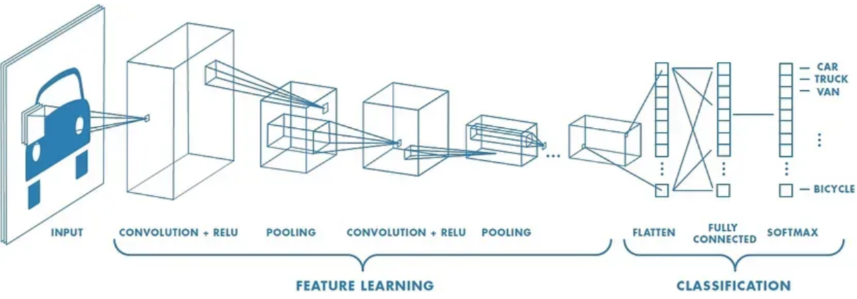
COMP6600 - Artificial Inteligence
INTRODUCTION
Convolutional Neural Network
Convolution;
Layers;
Applicability.
Auburn University
CNN layers example [7]

Slide 6
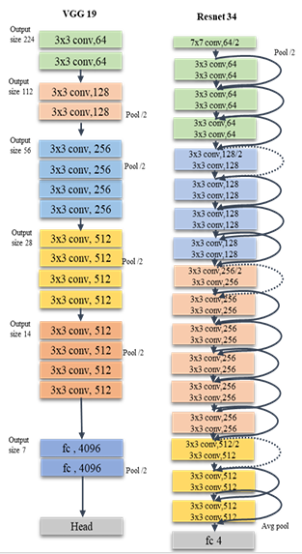
COMP6600 - Artificial Inteligence
INTRODUCTION
VGG19 architecture
Multiple convolutional layers;
Max-pooling;
Why choose this?
Deep architecture and simplicity.
Auburn University
Structure of the VGG19 and Resnet 34 models [1]

Slide 7

ORIGINAL IDEA
Create a AI model to classify eggs according to dirtyness parameter;
Became...
Implement CNN VGG19 model as it was made by [1]

Slide 8

COMP6600 - Artificial Intelligence
APPROACH
ChatGPT and Gemini usage
Dataset
~1500 egg images separated into 4 different classes [1]
Base model
Pre-process:
Img. Size = 224
Batch size = 64
Auburn University

Slide 9
COMP6600 - Artificial Intelligence
APPROACH
Base model
Base VGG19:
Pre-trained on ImageNet
Loss function = categorical crossentropy
Optimizer = Adam
Evaluation parameters:
Precision = exactness
Recall = completeness
F1-score = balance
Auburn University

Slide 10

COMP6600 - Artificial Intelligence
APPROACH
Base model
Overfitting:
Training and Validation accuracy/loss
Training = 10 epochs, weighted classes
Fine-Tuning (unfrozen 8 last layers)
Recompiled the model
Learning rate = 0.00001
Loss = categorical cross-entropy
Metrics = accuracy
Training = 5 epochs
The rest = base model
Auburn University

Slide 11
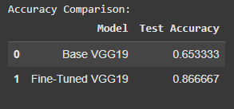
COMP6600 - Artificial Intelligence
EXPERIMENT
Ran the codes generated by ChatGPT troubleshooting as needed
Accuracy comparison between base and fine-tuned VGG19 models
Auburn University

Slide 12
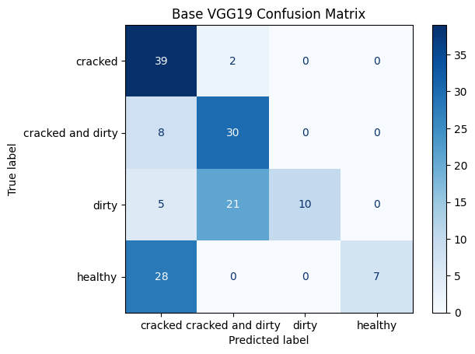
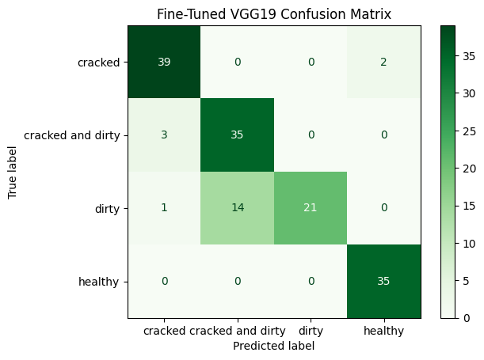
comp6600 - Artificial Intelligence
EXPERIMENT
Confusion Matrix of base model
Fine-Tuned VGG19 Confusion Matrix
Auburn University

Slide 13
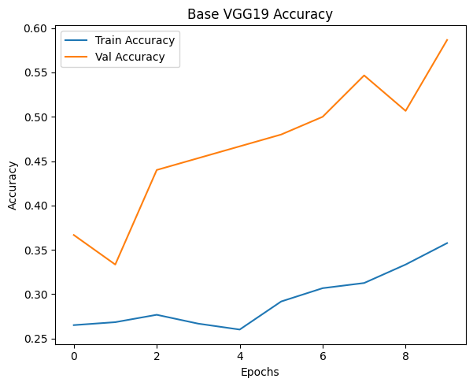
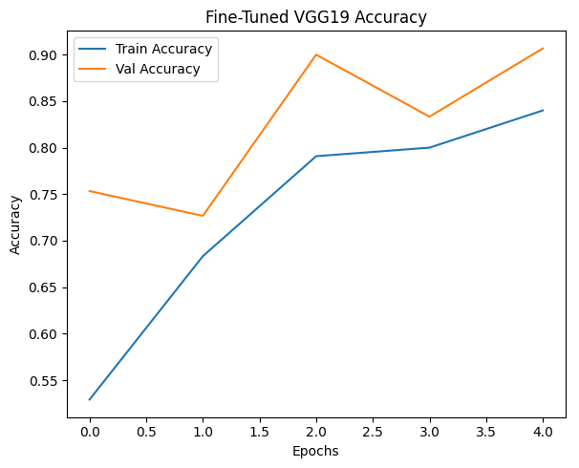
COMP6600 - Artificial Intelligence
EXPERIMENT
Base VGG19 accuracy plot
Fine-Tuned VGG19 accuracy plot
Auburn University

Slide 14
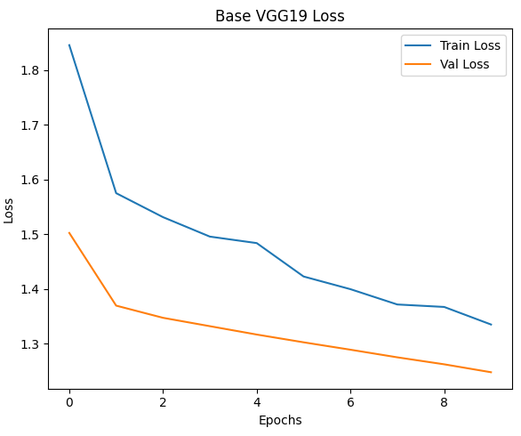
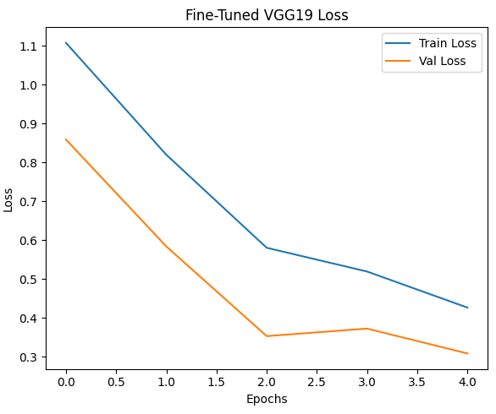
COMP6600 - Artificial Intelligence
EXPERIMENT
Base VGG19 loss plot
Fine-Tuned VGG19 loss plot
Auburn University

Slide 15
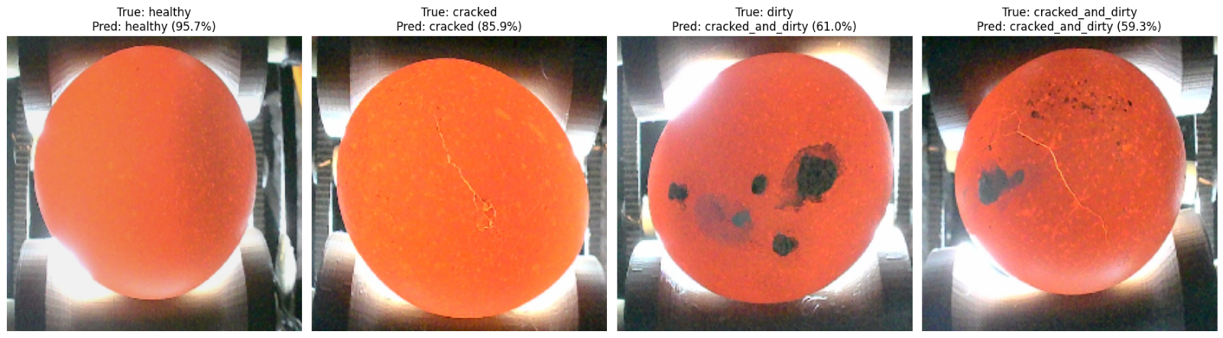
COMP6600 - Artificial Intelligence
EXPERIMENT
Egg images classifications using one image from the test set given by [1]
Auburn University

Slide 16
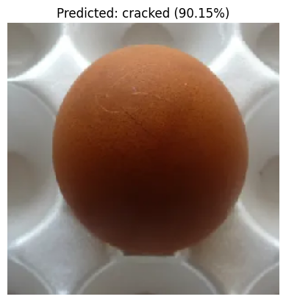
COMP6600 - Artificial Intelligence
EXPERIMENT
Egg image with a crack found online and classified using the implemented VGG19 model
Auburn University

Slide 17

COMP6600 - Artificial Intelligence
EXPERIMENT
Auburn University

Slide 18



CONCLUSIONS

Slide 19

COMP6600 - Artificial Intelligence
LOOKING AHEAD...
Application of class knowledge in my laborathory case
Oocysts counts
Necrotic enteritis
Auburn University

Slide 20
COMP6600 - Artificial Intelligence
REFERENCES
Sánchez, J. M. P., Moreno, L. A. O., Rodríguez, J. L. R., & Corro, I. D. M. (2023). Poultry Egg Classification System Using Deep Learning (pp. 1–6). 2023 5th International Congress on Human-Computer Interaction, Optimization and Robotic Applications (HORA). IEEE. https://doi.org/10.1109/HORA58378.2023.10156776
Dunkley C. S. A Dozen Egg Abnormalities: HOW THEY AFFECT EGG QUALITY, UGA Cooperative Extension Circular 1255, April 2022. Available at: < https://secure.caes.uga.edu/extension/publications/files/pdf/C%201255_1.PDF>
Simonyan K., Zisserman A. VERY DEEP CONVOLUTIONAL NETWORKS FOR LARGE-SCALE IMAGE RECOGNITION, Published as a conference paper at ICLR, 2015. https://doi.org/10.48550/arXiv.1409.1556.
Victor Massaki Nakaguchi, R.M. Rasika D. Abeyrathna, Tofael Ahamed. Development of a new grading system for quail eggs using a deep learning-based machine vision system, Computers and Electronics in Agriculture, Volume 226, 2024, 109433, ISSN 0168-1699. https://doi.org/10.1016/j.compag.2024.109433.
Çelik A., Tekin El. Classification of Hatchery Eggs Using a Machine Learning Algorithm Based on Image Processing Methods: A Comparative Study, Brazilian Journal of Poultry Science, e-ISSN: 1806-9061 2024 / v.26 / n.2 / 001-012. http://dx.doi.org/10.1590/1806-9061-2023-1882.
KHABISI, M. M, SALAHI, A, & MOUSAVI, S. N (2012). The influence of egg shell crack types on hatchability and chick quality. Turkish Journal of Veterinary & Animal Sciences 36 (3): 289-295. https://doi.org/10.3906/vet-1103-20
Modi, P. Convolutional Neural Networks for Dummies, Medium, 2023. Available at: https://medium.com/@prathammodi001/convolutional-neural-networks-for-dummies-a-step-by-step-cnn-tutorial-e68f464d608f. Accessed: 07/23/2025.
Auburn University

Slide 21




COMP6600 - Artifical Intelligence
THANK YOU!
FOR YOUR ATTENTION
324-870-9034
mzp0199@auburn.edu
Auburn, AL
Auburn University

